Slide 1
Spatial Attention EEG Experiment Manual
Akira Takeuchi
ver. 07/01/2024

Slide 2
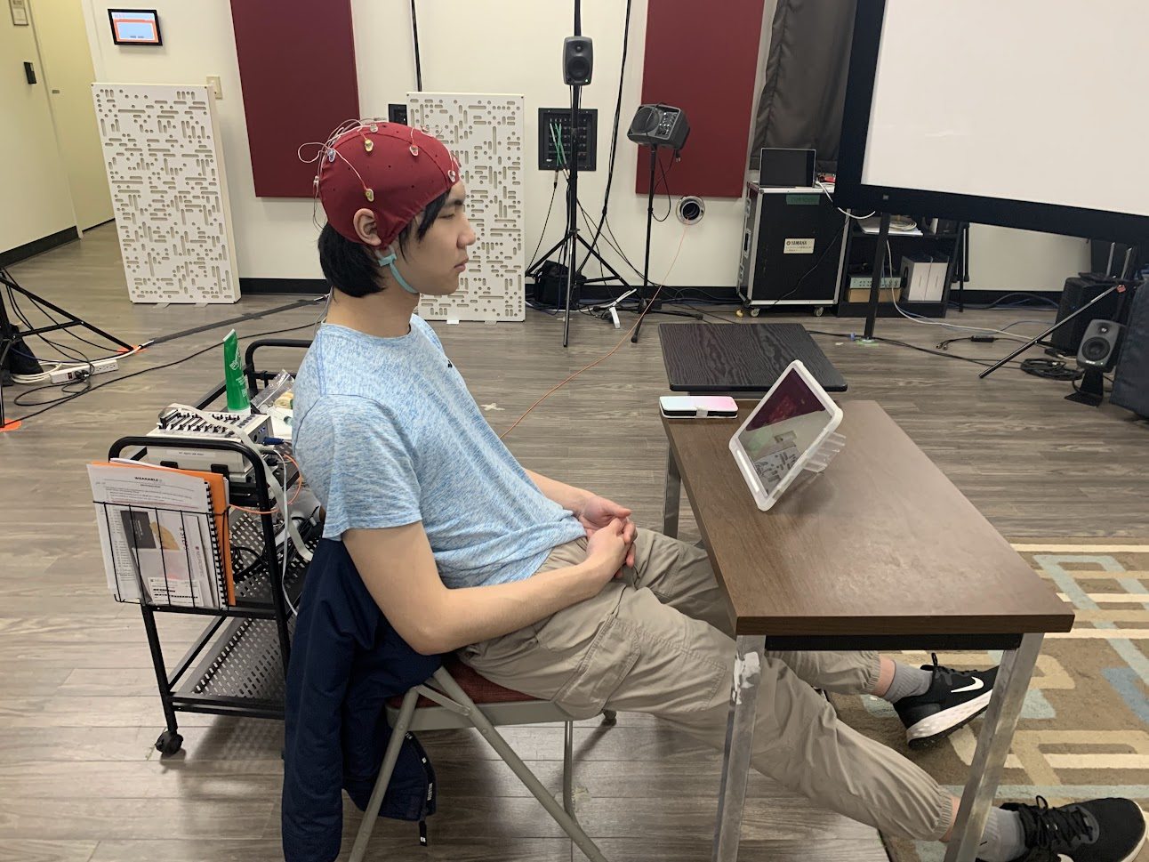
-> Examine the listeners’ response against spatially Masked speech (Spatial Attention) #Speech Recognition Threshold (SRT) task #use CRM corpus #EEG measurement Scripts are available at: https://github.com/50516021/DSI24tutorial/tree/main/SpatialAttention_exp
Purpose

Slide 3
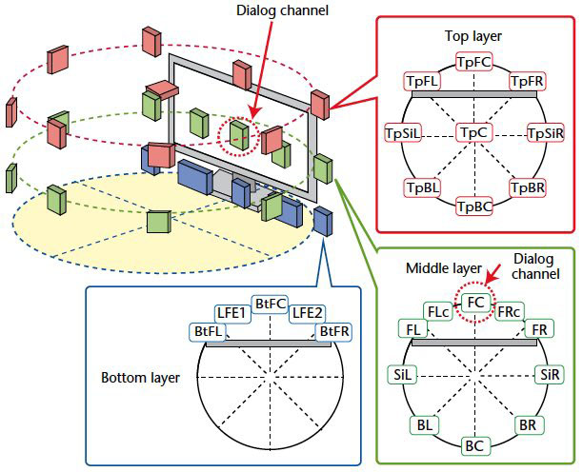
Studio setting
・use FL, FR, and BC in 22.2ch
・ L/R has 45 degrees from the center line
picture from:
https://www.nhk.or.jp/strl/english/publica/bt/64/6.html

Slide 4
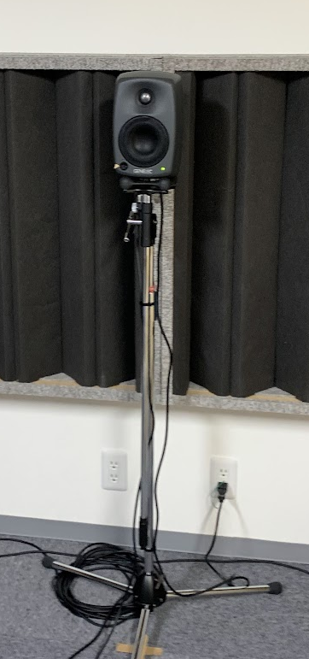
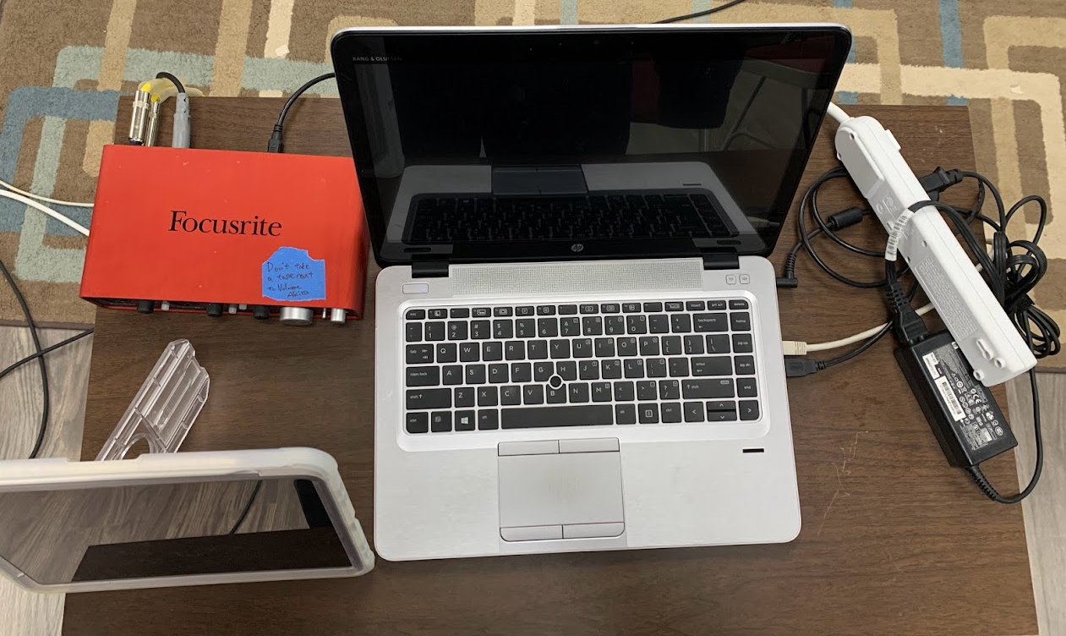
Requirements [Hardware]
PC with MATLAB
Windows PC with DSI-Streamer
-> They can be one PC, but better to be separated
Audio Interface
Audio cables
iPad with TouchOSC mk1 app
3 Loudspeakers
A network can be shared
between the PC and iPad

Slide 5
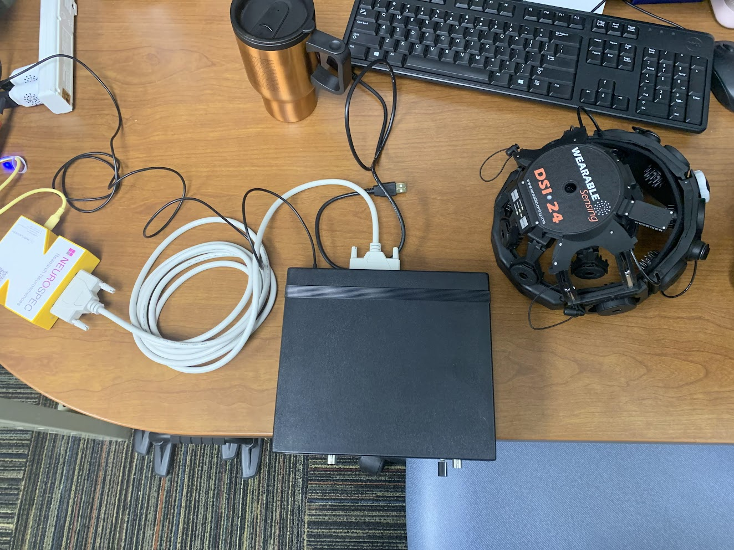
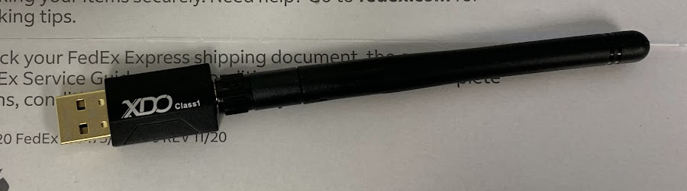
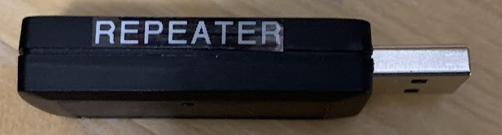
Requirements [Hardware: DSI-24 set]
Trigger hub power cable
DSI-24
Wireless receiver
MMBT USB cable
DSI-streamer PC
MATLAB PC
BT dongle
Wireless repeater
MMBT Trigger generator
Trigger cable
Trigger hub

Slide 6
Location (channel) setting
target :L
masker :
・co-located -> L
・separated (same side) -> R
・separated (opposite side) -> BC (Back Center)
→most practical situation
investigate SNR threshold which can make differences between each channel configuration
L
R
BC

Slide 7

DSI-24 System Diagram
Speaker
DSI-24
Recording on EDF/CSV file
Can be set in separate spaces without a wired connection
Wireless
Repeater
Wireless receiver
Sound
Audio interface
Trigger
EEG & Trigger
Sound
PC1 (Mac)
Wireless
Trigger Hub
Trigger
MATLAB
PC2 (Windows)
Wireless
repeater
EEG & Trigger
DSI streamer

Slide 8
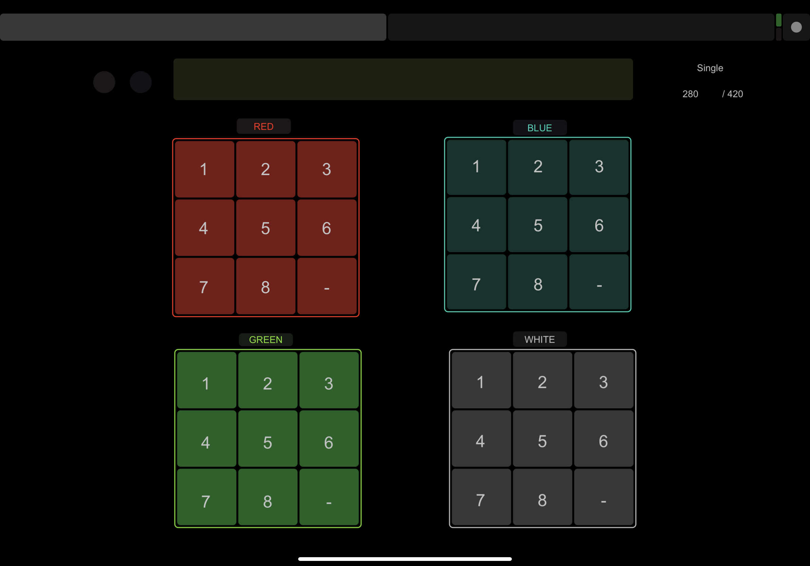
Requirements [Software]
[Recording PC]
DSI-Streamer
Blue Tooth Driver
[Experiment PC]
MATLAB
cloned scripts from GitHub repo
[iPad]
TouchOSC mk1
load the template ‘SpatialAttention.touchosc’

Slide 9
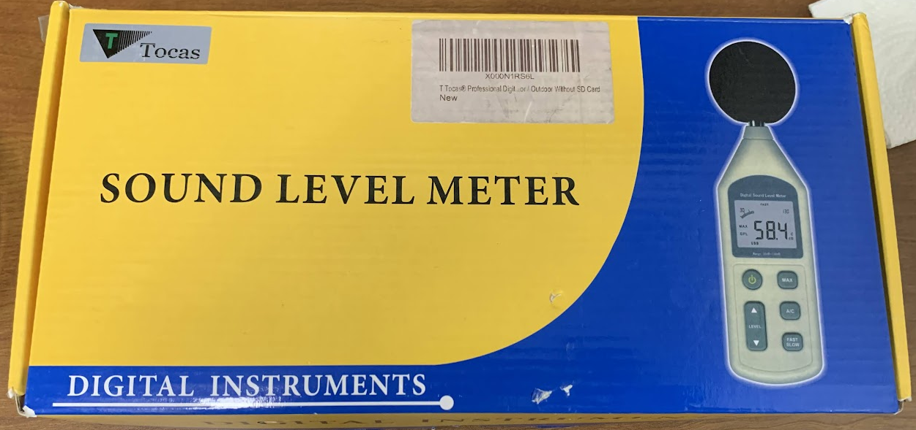
Preparation - Sound Calibration
① Connect the Audio Interface to the Speakers
② Connect the Audio Interface before starting MATLAB
③ Test the Volume with ‘Soundtest.m’ and tune all the speakers for 57 dB at the listening point
(masker sound is tuned to be 70 dB SPL with this calibration)

Slide 10
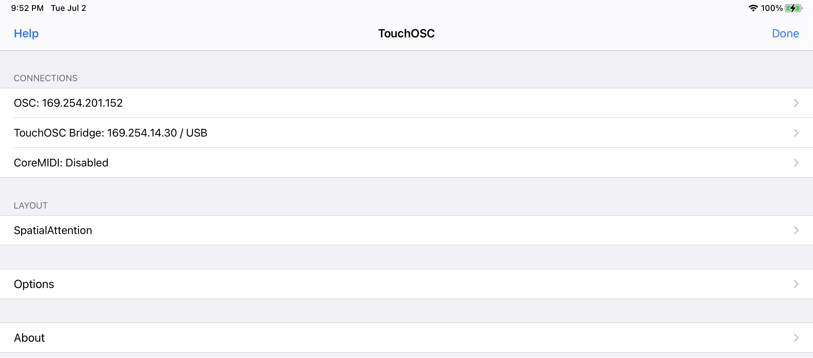
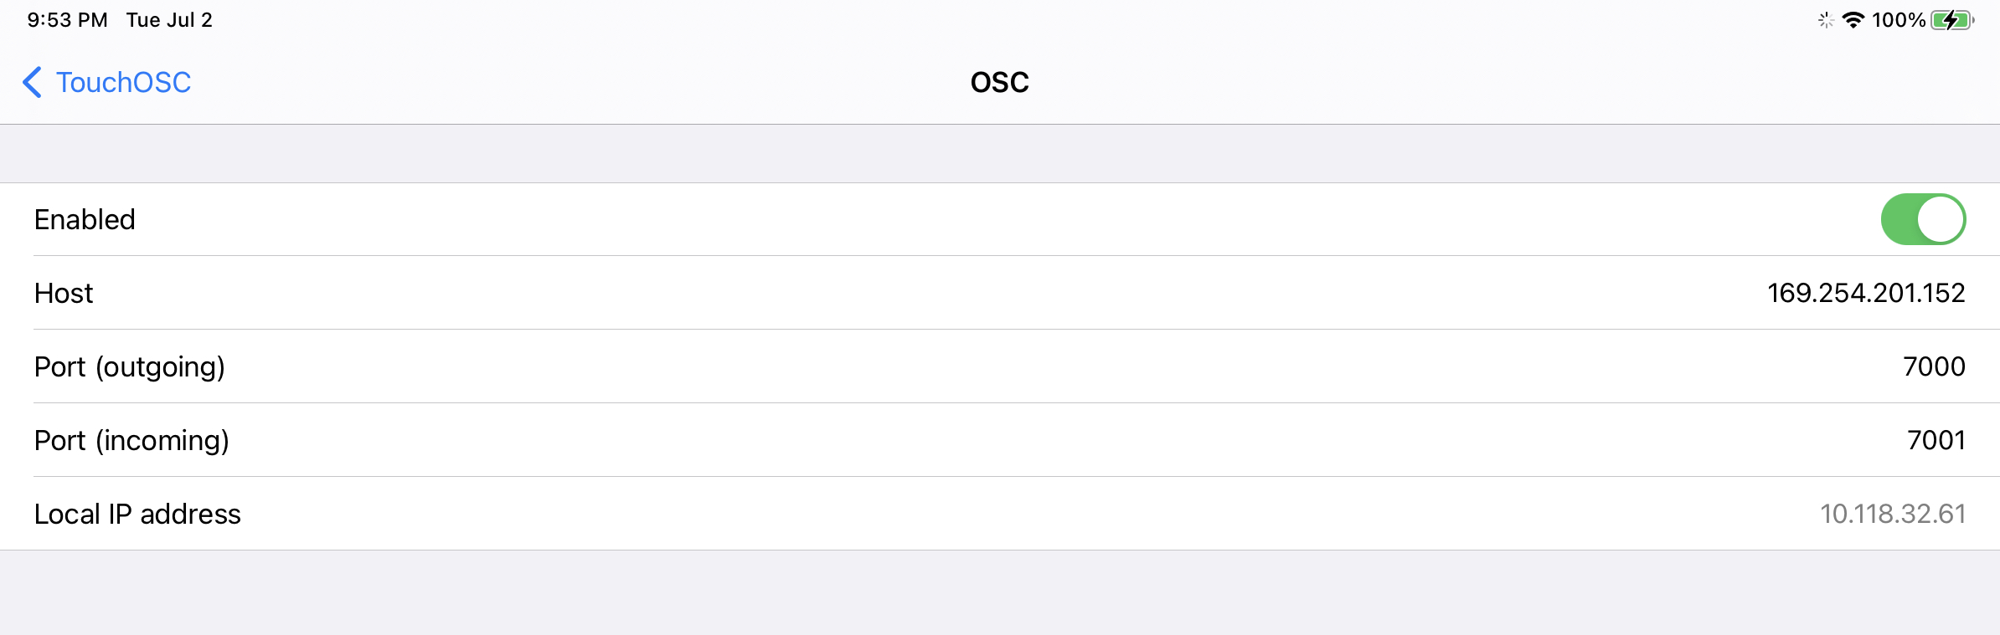
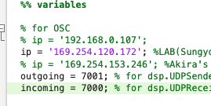
Preparation - Network
① Make sure that the laptop and the
iPad are connected to the same Wi-Fi
② Open Matlab on the laptop
③ Open TouchOSC on the iPad
④ Make sure your IP address and
port numbers on both MATLAB codes
and touch OSC
⑤ run ‘OscConnectionTest.m’ and make sure the connection between the PC and iPad
PC address
iPad address

Slide 11
Preparation - Trigger
① Make sure the trigger receiver is fully charged and inserted into DSI-24
② run ‘makeTrigertest_BDF.m’
④ Make sure the triggers appear in the DSI-streamer screen

Slide 12
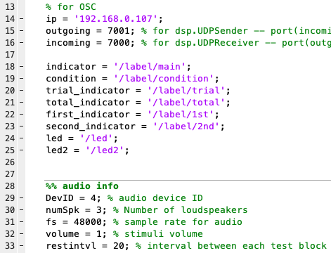
Run [Variables ①]
- SpAt_main.m -
check:
・port number (iPad as well)

Slide 13
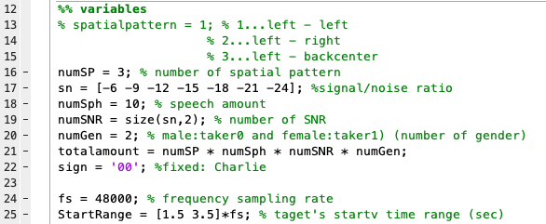
Running [Variables ②]
- +data_load/makestimuluslist.m -
(function script)
check:
・[sn]
the value of all SNR you want to try
・[numSph]
number of trials of each condition
・[StartRange]
variation of the start time of target sound

Slide 14
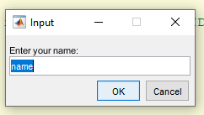
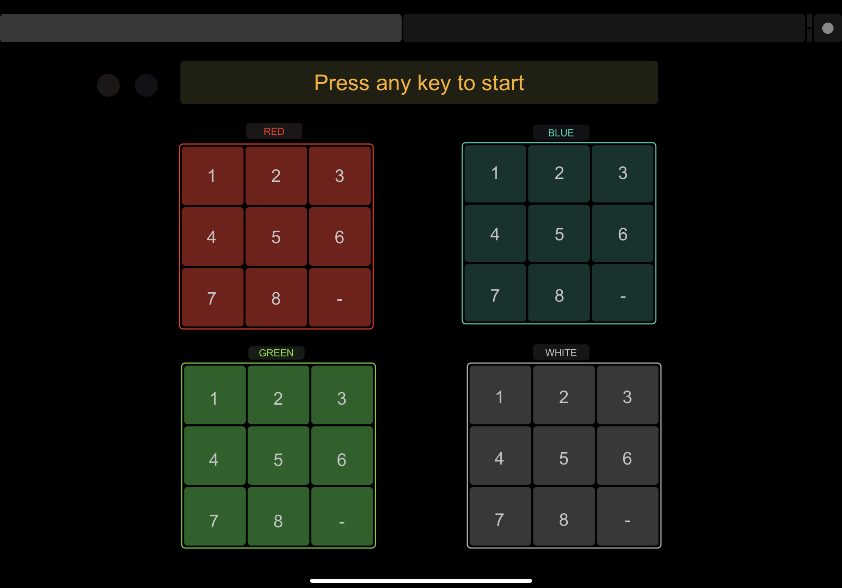
Running [procedure]
① Make sure every variable
② Run ‘SpAt_main.m’
③ Enter the participant’s name into a popup window
- Do not include ‘_’ in the participant’s name
④ Press any button on the iPad and start the experiment

Slide 15
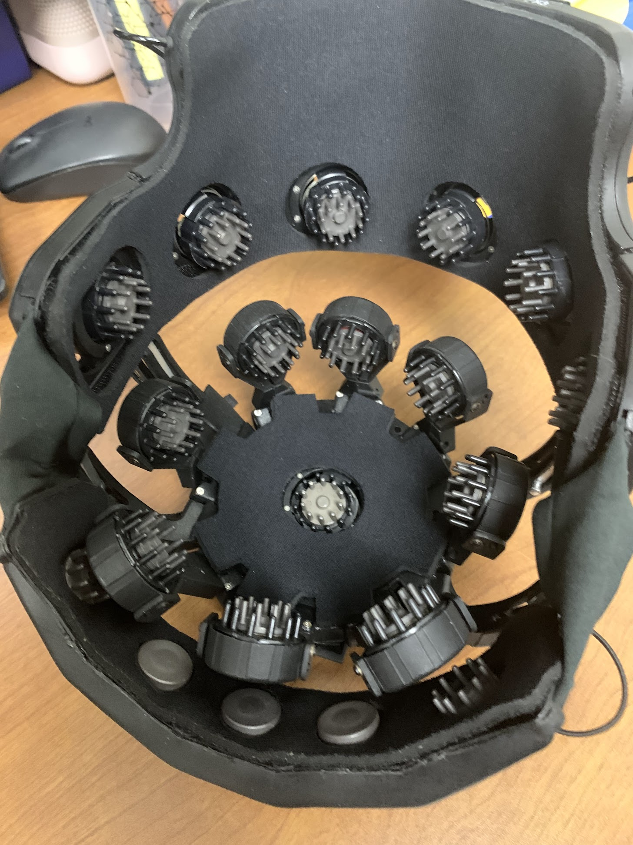
DSI-24 - Comfortability
Doesn’t require gel, so…
Participants can easily manage schedules
(don’t need to care about their hair)
The position can be easily changed
Can be used wireless, so…
Can pause the experiment and take breaks
Flexible, stress-free movement

Slide 16
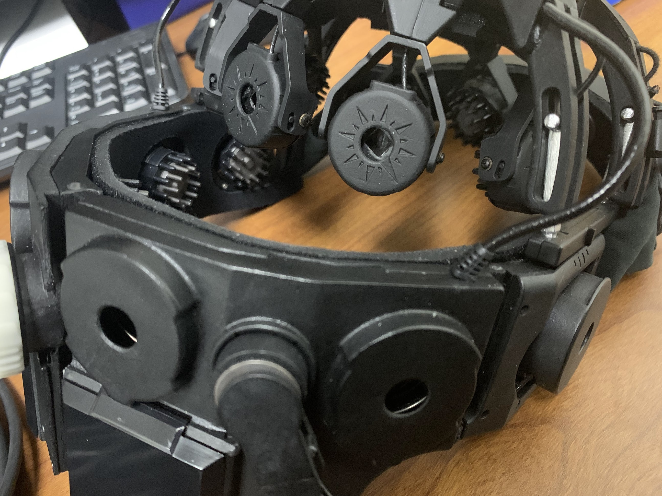
DSI-24 - Robustness
Each electrode has an independent amplifier, so…
robust to an external electric field
Entire the structure can fit and hold the participant’s head
robust to movement
stable position

Slide 17
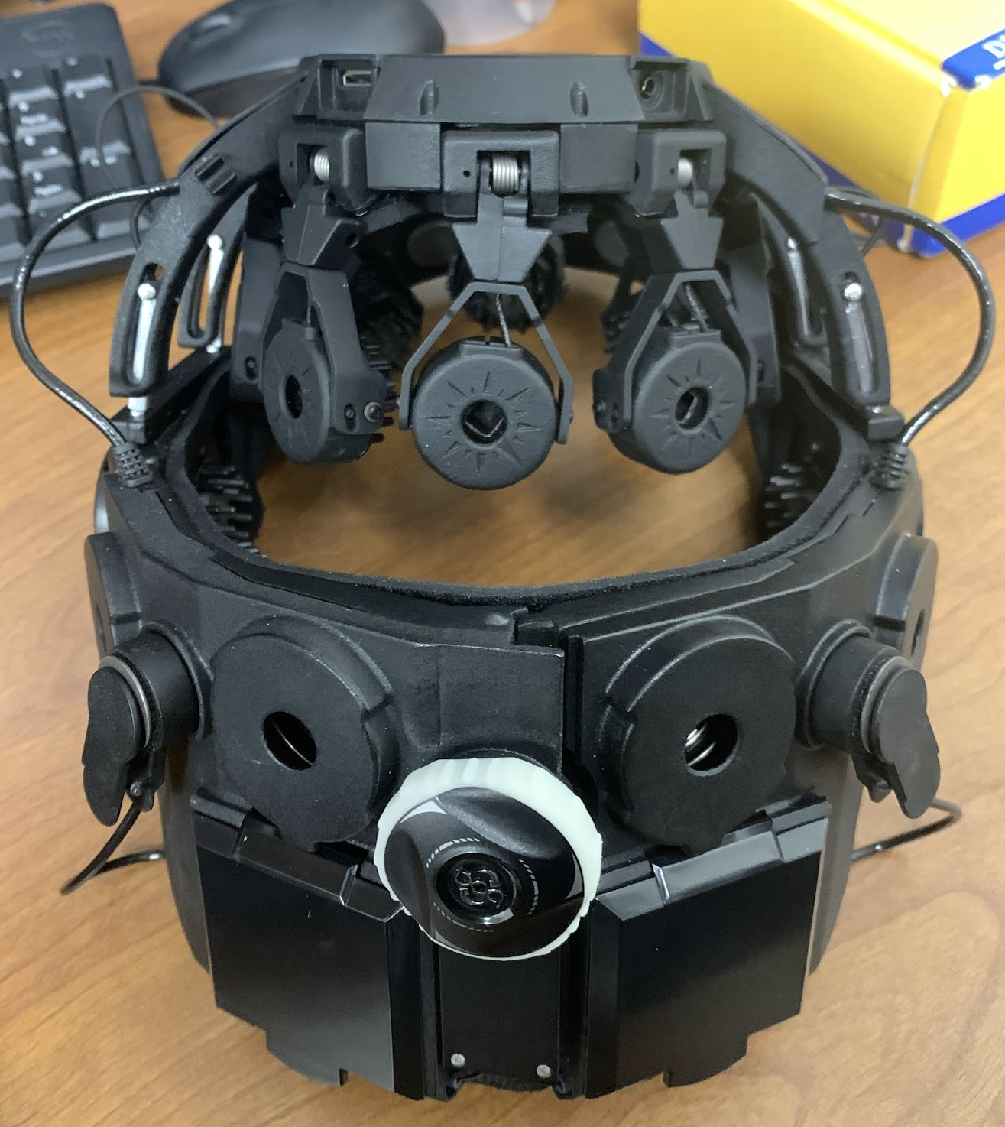
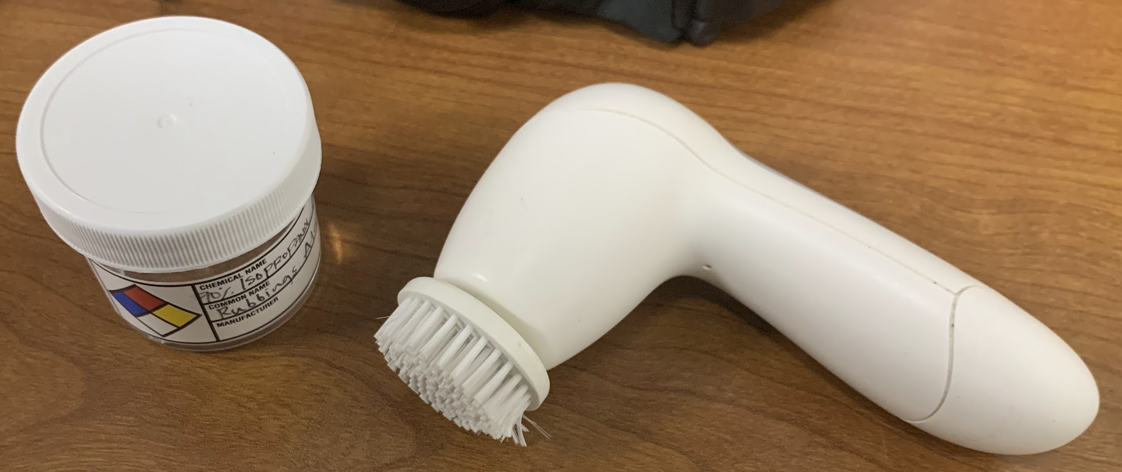
DSI-24 - Setup & Care
Has one touch nob and an independent top piece
can be easily and quickly set
The headset can be cleaned with the brash with sanitizer
reduce the time for care
several experiment sessions in a day

